Slide 1
NTL Data: Extraction and Visualisation
- Khushi Saxena
Summer Intern 2023

Slide 2
VISUALISATION
The quarterly data is visualised in 4 separate ways:
1. ACs with most amount of radiation for year 2022.
2. Top 5 ACs with the biggest growth jump from 2016 to 2022.
3. Percentage Growth from previous year per AC.
4. ACs with highest percentage delta (2022-2016).

Slide 3
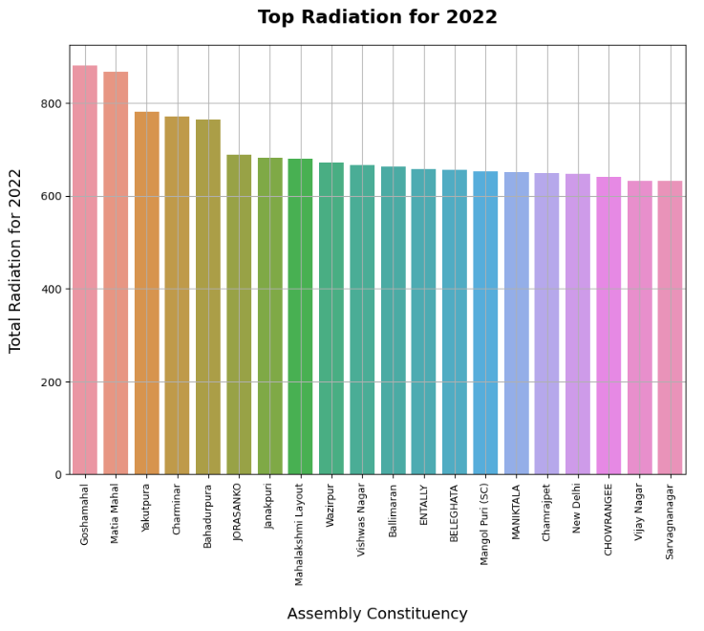
1. ACs with most amount of radiation for year 2022.
Mainly areas from Hyderabad, Delhi and West Bengal

Slide 4
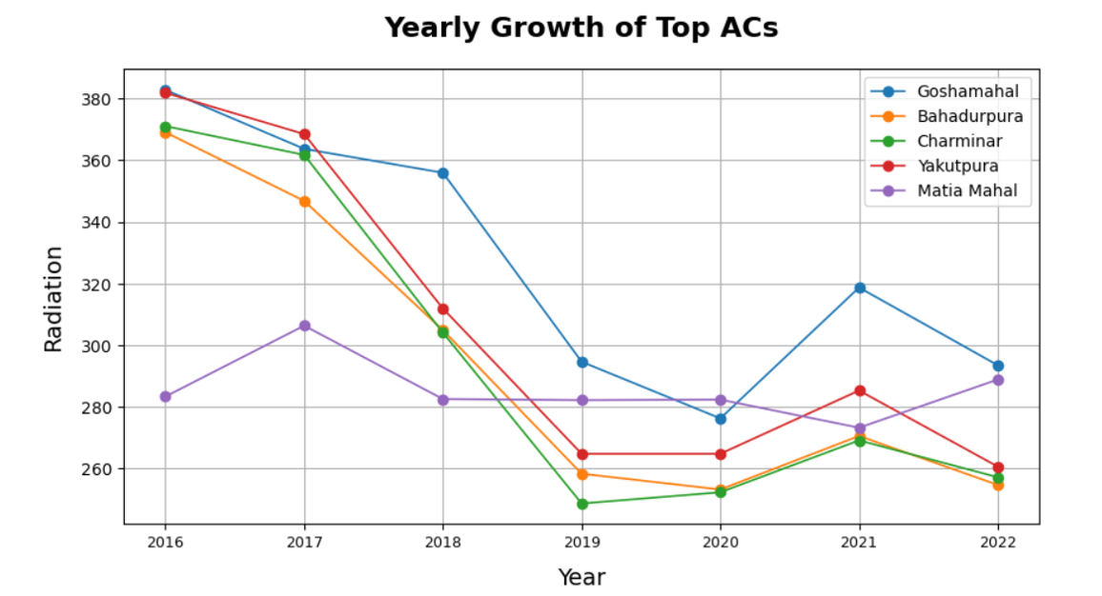

Slide 5
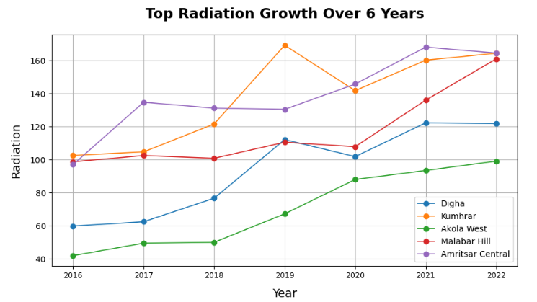
2. Top 5 ACs with the biggest growth jump from 2016 to 2022.
Digha – Navi Mumbai
Kunhrar – Patna
Akola West – Akola
Malabar Hill – Mumbai
Amritsar Central - Amritsar

Slide 6
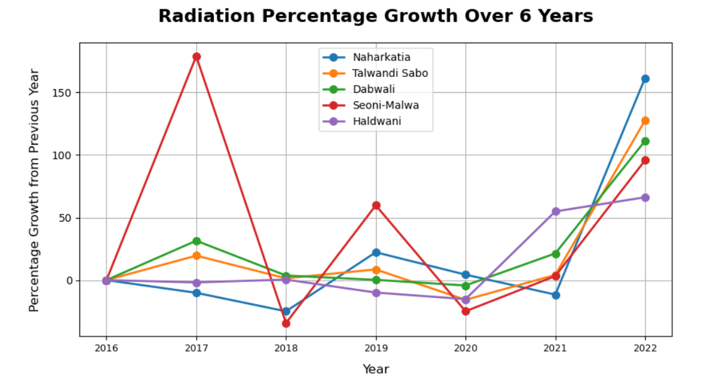
3. Percentage Growth from previous year per AC.
Naharkatia - Assam
Talwandi Sabo - Punjab
Dabwali - Punjab
Seoni Malwa - MP
Haldwani - Uttarakhand

Slide 7
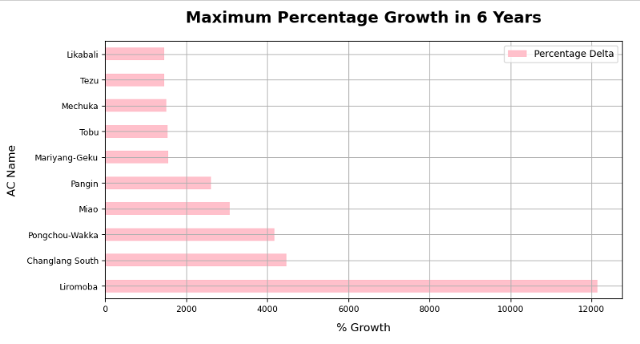
4. ACs with highest percentage delta (2022-2016).
Arunachal Pradesh, Assam and Nagaland.

Slide 8
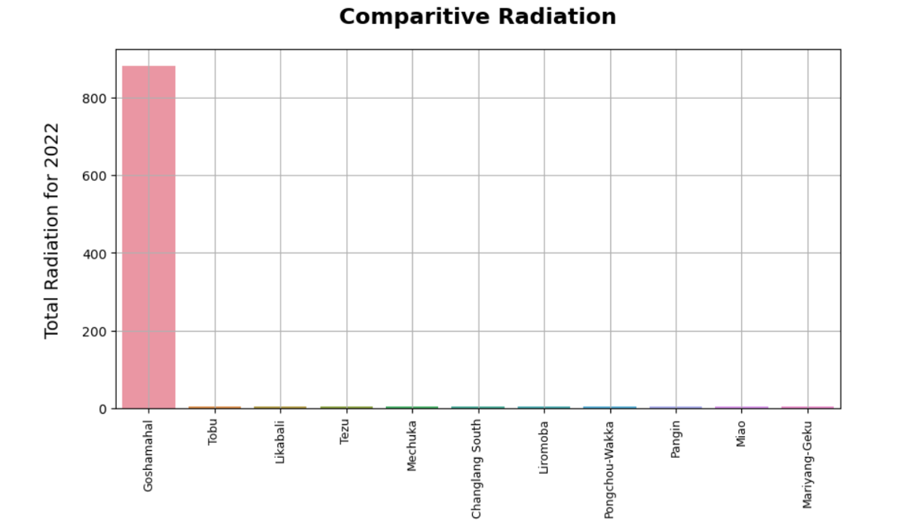
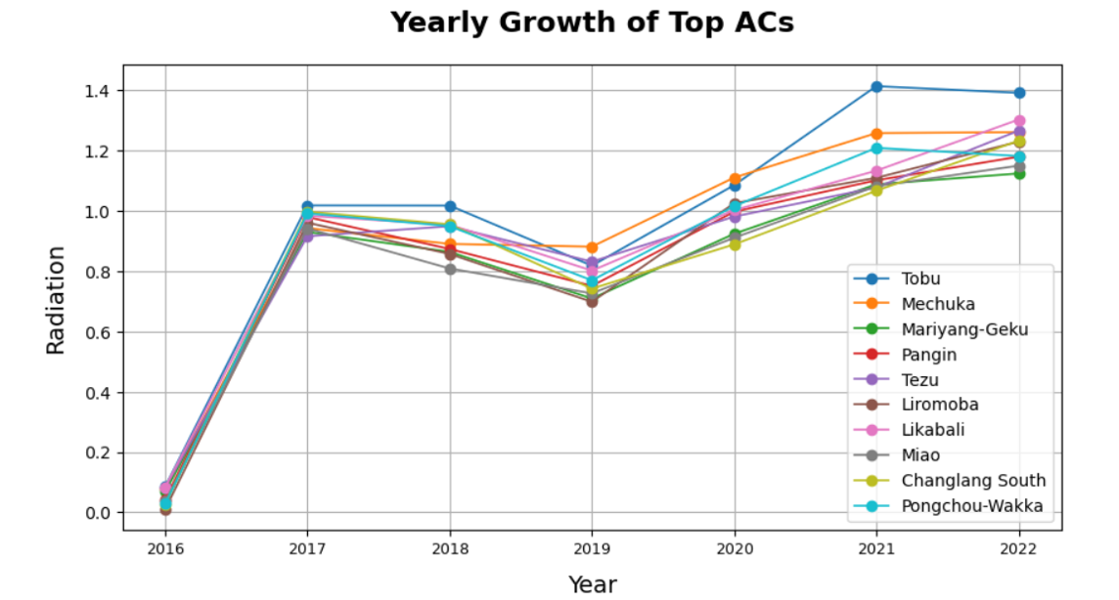
4. ACs with highest percentage delta (2022-2016).

Slide 9
RECOMMENDATIONS AND OBSERVTIONS
Districts from Hyderabad and Delhi show consistently high absolute statistics. This may indicate that certain areas are already being worked upon by other organizations.
Districts from the northeastern regions do not have high absolute figures, but they show tremendous potential for growth and can be kept on the radar and monitored.
South Indian districts did not show up in the top statistics of any measure.

